Slide 1
AP2C – Reversible Instance Normalization (RevIN)
Ching Chang
Kim, Taesung, et al. "Reversible instance normalization for accurate time-series forecasting against distribution shift." International Conference on Learning Representations. 2021. (ICLR 2022 Poster)

Slide 2
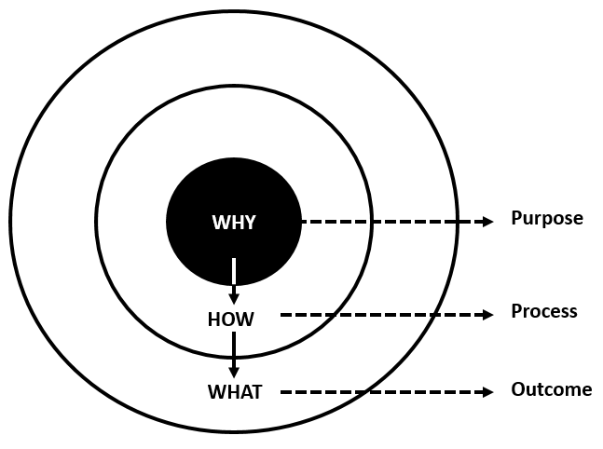
Golden Circle
Q1: Why?
Why do we need this?
Q2: How?
What’s the experimental results on their paper?
How do they achieve this?
Q3: What?
What’s the outcome when we integrate this into ptstoolkit-pt?

Slide 3
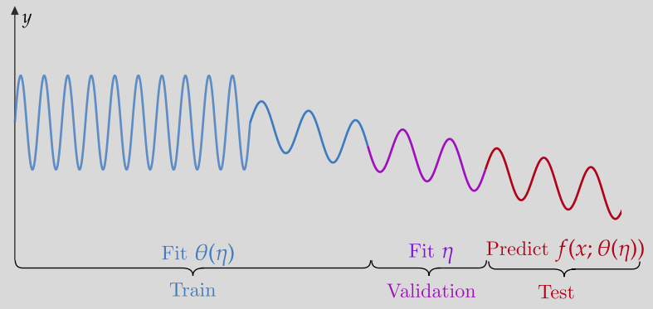
Q1: Why? – Why do we need this?
Statistical properties such as mean and variance often change over time in time series, i.e., time-series data suffer from a distribution shift problem.

Slide 4
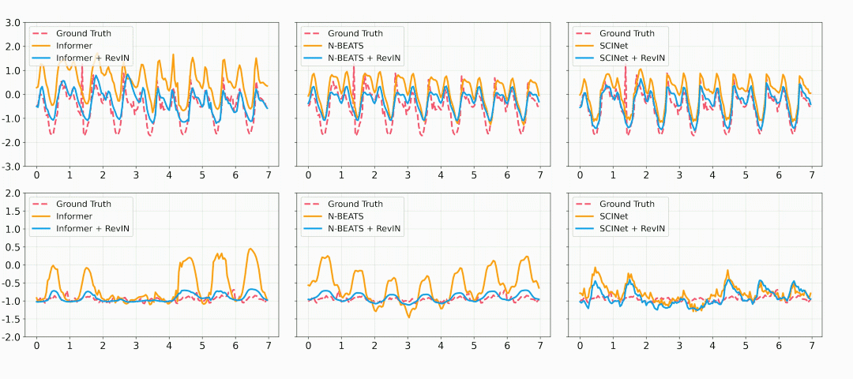
Q2: How? – What’s the experimental results on their paper?

Slide 5
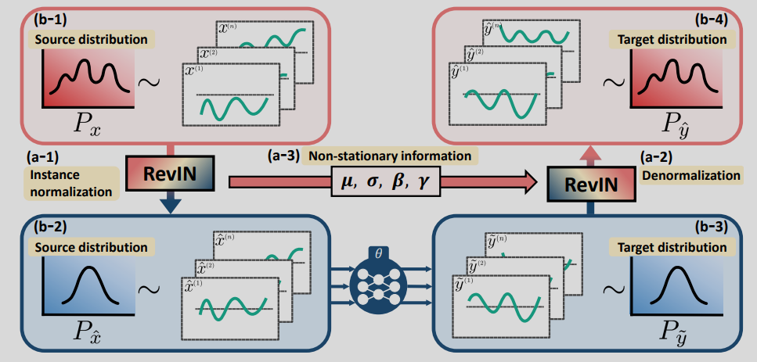
Q2: How? – How do they achieve this?
RevIN = IN in the input layer, and reverse it in the output layer
Input layer
Output layer

Slide 6
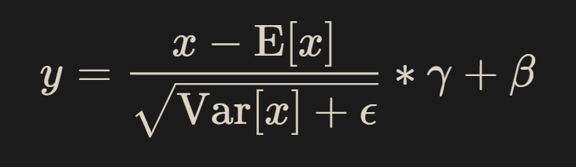
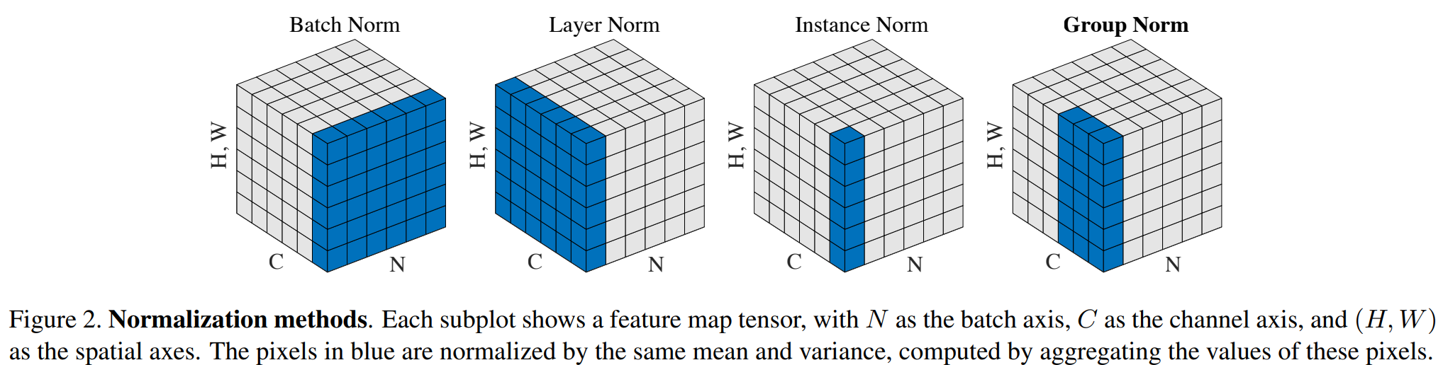
Normalization Layers
Affine
shift → scale → re-scale → re-shift
learnable

Slide 7
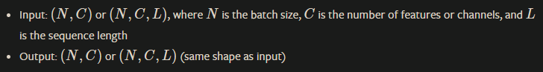
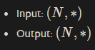
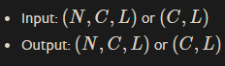
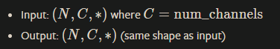
Normalization Layers
nn.BatchNorm1d
nn.LayerNorm
nn.InstanceNorm1d
nn.GroupNorm
(B, C, T) → (B, C, T)
BN
(B, C, T) → (B, C, T)
LN
(B, C, T) → (B, C, T)
IN
(B, C, T) → (B, C, T)
GN

Slide 8
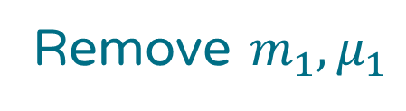
Z-Score Normalization
Remove $m_{1}, μ_{1}$
Hidden layer
Input layer
1’
2’
3’
1
2
3
1’
2’
3’
1
2
3
1’
2’
3’
1
2
3
1’
2’
3’
(B, C, T) → (B, C, T)
z-score

Slide 9
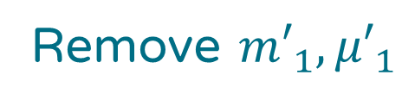
Instance Normalization
Remove ${m′}_{1}, {μ′}_{1}$
Hidden layer
Input layer
1’
2’
3’
1
2
3
1’
2’
3’
1
2
3
1’
2’
3’
1
2
3
1’
2’
3’
(B, C, T) → (B, C, T)
IN

Slide 10
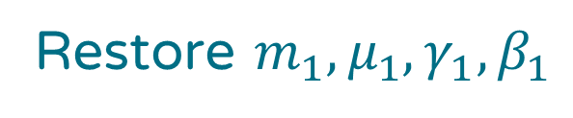
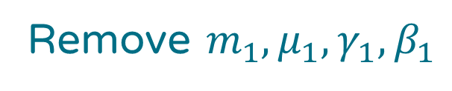
RevIN
Remove $m_{1},μ_{1},γ_{1},β_{1}$
Hidden layer
Restore $m_{1},μ_{1},γ_{1},β_{1}$
Input layer
Output layer
…
1
2
3
1’
2’
3’
…
1
2
3
1’
2’
3’
…
1
2
3
1’
2’
3’
…
(B, C, T) → (B, C, T)
RevIN_{remove}
(B, C, T) → (B, C, T)
RevIN_{restore}

Slide 11
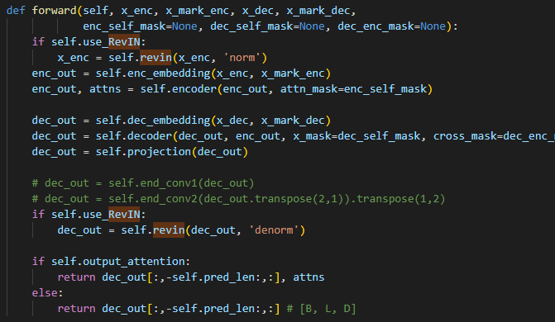
forward() in Informer

Slide 12
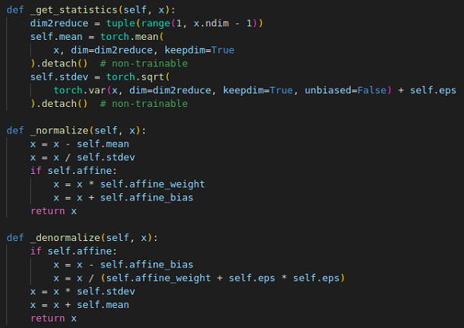
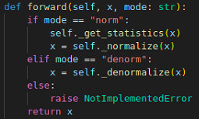
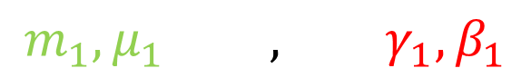
class RevIN(nn.Module)
Ironically, RevIN accepts input in the format (B, T, C) rather than (B, C, T).
(B, …, C)
dim2reduce
shift → scale → re-scale → re-shift
$$m_{1},μ_{1} , γ_{1},β_{1}$$
shift ← scale ← re-scale ← re-shift
Non-trainable
(Dynamically determined)
Trainable
(Affine)

Slide 13
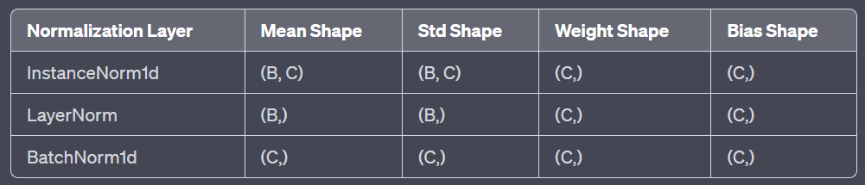
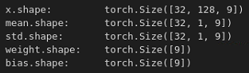
RevIN’s shape
Ironically, RevIN accepts input in the format (B, T, C) rather than (B, C, T).
Affine
(B, T, C)
(B, 1, C)
(B, 1, C)
(C,)
(C,)

Slide 14
Thank you

